Slide 1
Softskills Day
“Elevator Pitch”
Kenny Nguyen

Slide 2
Learning Outcomes
Know what an elevator pitch is all about
Be able to construct a simple yet impactful elevator pitch ☺
Be able to use this in a situation where critical thinking, problem solving and communication are all required.
Notes:
Explain the backend code here

Slide 3
What is an Elevator Pitch and Why is it important to me?
“So what do you do”
Situations
Building a network
Landing a job
Connecting with colleagues on your first day of work
Meeting new people and making friends.
Gain confidence!
Notes:
In the context of employment – an Elevator pitch is a quick synopsis of your background and experience. The “Elevator” part is that it should be short enough to present during a brief elevator ride.
It’s pretty much an answer to “So what do you do” – the golden tinder / bumble question wink wink.
Elevator pitches become particularly important and can be called upon when you are:
Trying to build connections with people that you may or may not know
Landing a new job – being able to talk to employers who are talking to 1000’s of other candidates
Connecting with colleagues on your first day of work – particularly important during these times of COVID.
Meeting new people – gives them a quick glimpse of who you are – think of it as an executive summary of yourself but given in a person to person context.
All these help you gain more confidence in speaking with people and introducing yourself!

Slide 4
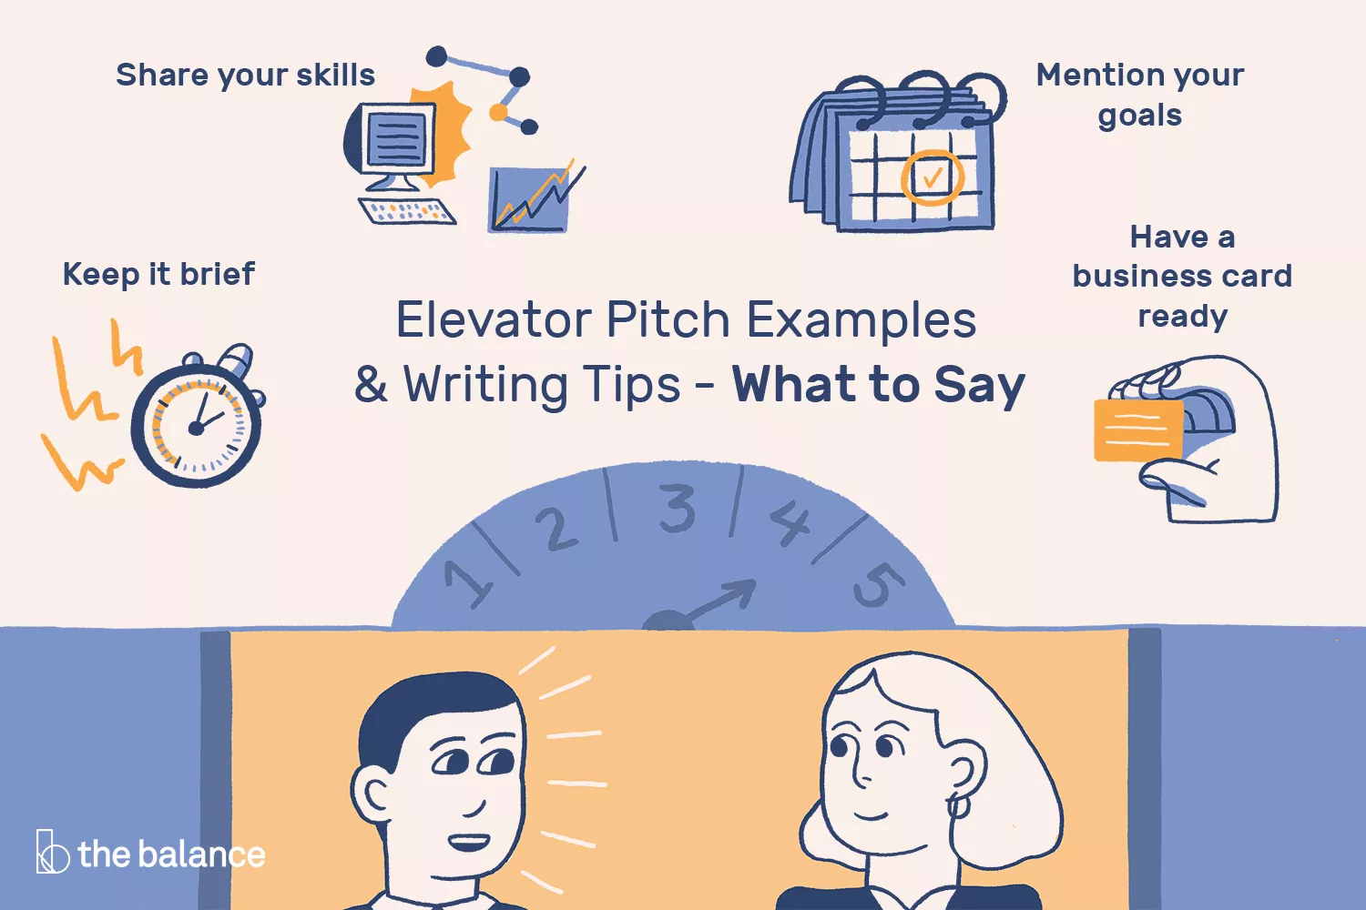
Notes:
Explain the backend code here

Slide 5
Tips and tricks to creating an elevator pitch
Three main types of elevator pitches
General – elevator pitches for job seekers to use at networking events, job fairs, career expos etc.
Elevator speech for interviews
“Sales pitch” to get stakeholders interested in your product.
Keep it short and sweet.
Get specific, talk about actions.
Provide examples, or attention grabbing facts.
Notes:
Keep it short and sweet – no one wants to hear about your life story / what you had for breakfast or your favourite fast food chain is.
Get specific and talk about some actions. Yeah sure, don’t talk the talk if you cant walk the walk. Tell me more! Interest me by things and actions I can do!
Providing eye opening, interest grabbing facts are the best.

Slide 6
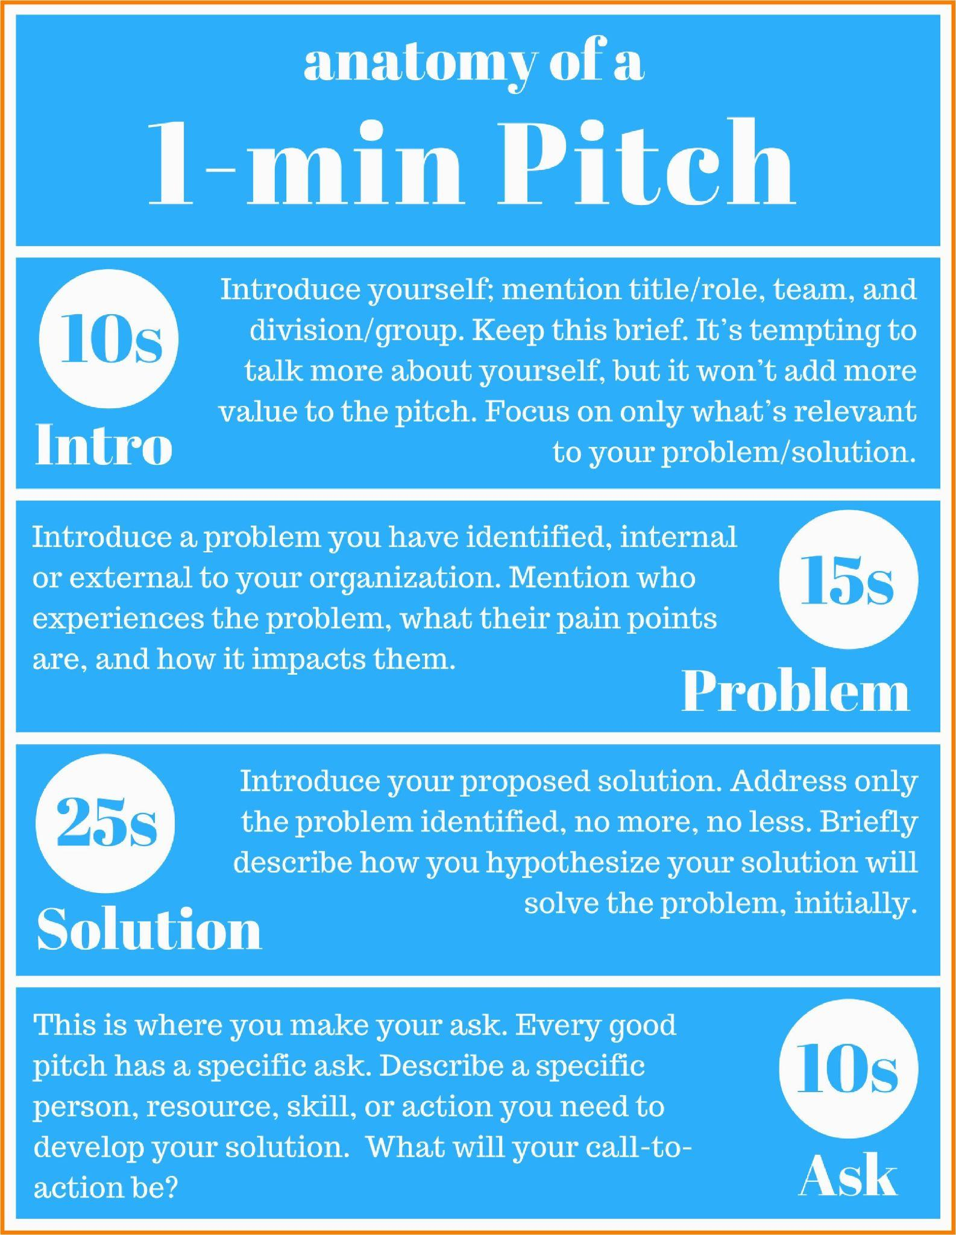
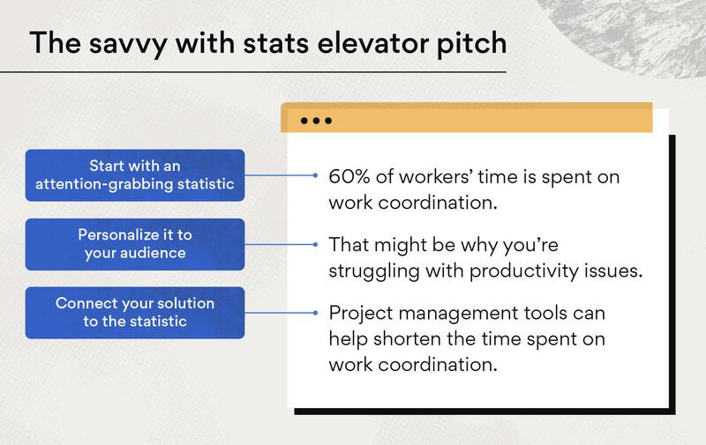
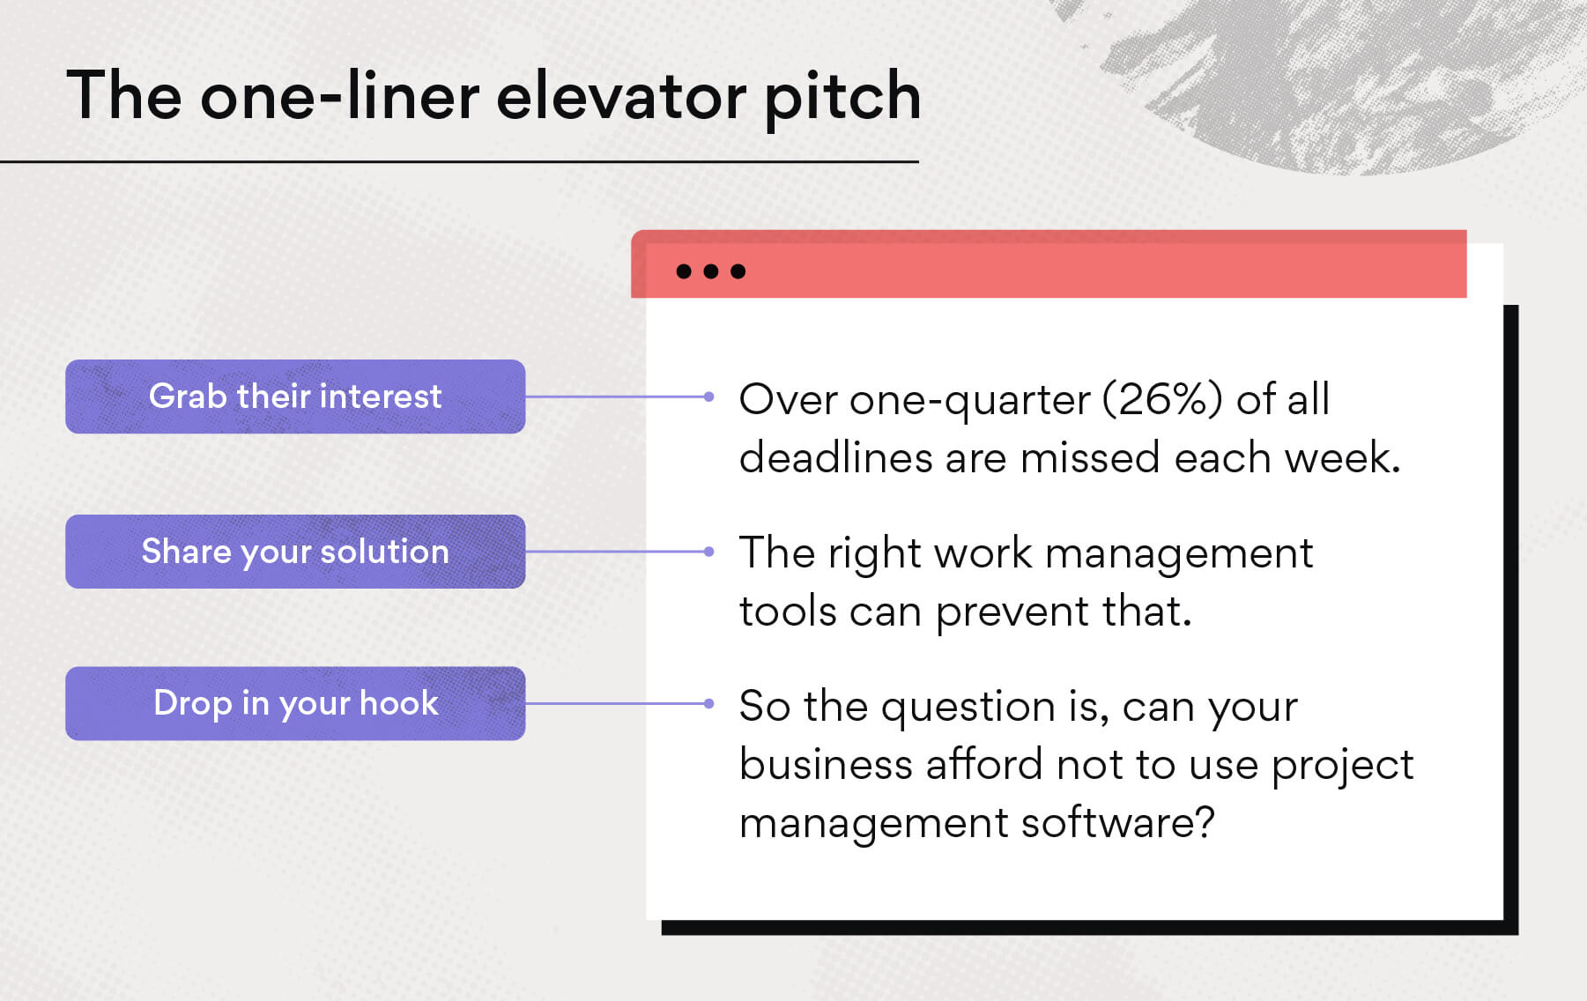

Slide 7
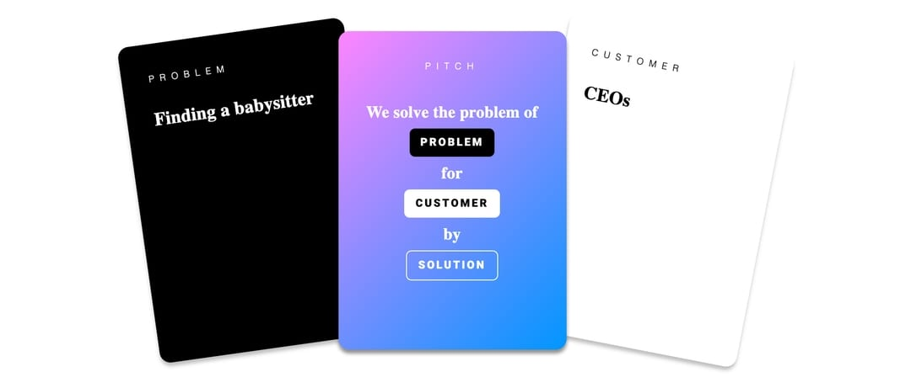
Lets get right into the Activity!
Notes:
Since throughout the day you’ve been all getting to know eachother within your own groups – lets start off with a chill icebreaker type elevator pitch.
This is based off the game “Elevator Pitch” which is essentially Cards against humanity but you get a problem to solve for a customer.
What I will do is give you 10 minutes each to get into pairs – preferably someone you might not have worked with before, I will give your pair a “Problem” and a “Customer”.
Your goal is to pitch me a solution to that problem for your customer.
To keep this short and sweet we will limit this to, and structure this using the “One Liner” elevator pitch approach, so remember:
Grab the users interest. This can be by facts, comedic etc.
This is where you share your solution – it should link nicely with your opener.
Drop your hook - get your users interested and sell your product.
E.g.
---------------------------------------------------------------------------------------------------
Over one-quarter (26%) of all deadlines are missed each week because of a lack of clarity.
But with the right project management tools, that number could be much lower.
So the question is, can your business afford not to use project management software?
------------------------------------------------------------------------------------------------
Has your boss ever asked you to "whip up a quick report before the end of the day"?
You say yes with a sinking heart — because you know it'll be the opposite of quick.
The founders of my company, AnswerASAP, constantly dealt with this problem in their roles as marketing executives.
So they created a tool that puts all your data in one place and creates unique reports within 30 seconds or less.
-------------------------------------------------------------------------------------------------
I’m a Senior Project Manager with a creative attitude to problem solving [Professional Persona].
In my current position as Chief of Project Management at Seton Hospital, my recent challenge has been the reduction of stockroom waste [Problem].
I introduced a new kanban system and designed Lean training programs [Action] to be carried out across all departments.
We managed to cut stockroom waste by 65% which, ultimately, slashed monthly costs by a quarter [Result].
I know cost-saving solutions for the infant ward are amongst your key priorities. I’m sure I can use my expertise to achieve great results with this initiative [Your offer].
--------------------------------------------------------------------------------------------------
My company develops and designs personalized online sales funnels [what your company does].
That means two things: one, online customers enjoy a flawless user experience tailored to their needs and interests, and two: our clients get automated solutions that dramatically boost sales [unique business proposition].
We helped our last client increase online revenue by 120% month-on-month [hard numbers behind your results].
Does your company have any experience with ecommerce automation? [engaging question]
-----------------------------------------------------------------------------------------------------
I want to test your creativity. Lets start with the example for team one (or if they are not in pairs just give them singular).
2nd person:
Problem - Getting the smell of onion out of your breath.
Customer - Elon Musk’s personal assistant.
Problem -

Slide 8
Elevator Pitch! Lets get creative!
Problem - Not getting exactly what you want for Christmas
Customer - Children
Solution - ????
Problem - My phone is too big to fit in my favourite pants pocket
Customer - Working professionals
Solution - ???
Problem - Finding a babysitter
Customer - CEO’s
Solution - ????
Problem - Getting the smell of onion out of your breath
Customer - Elon Musk’s Personal Assistant
Solution - ???
Problem - Slowing down of iPhone’s each year when Apple releases new iPhones
Customer - College students
Solution - ???
Notes:
Choose a problem, customer and lets construct one in your teams! Help eachother, create your own or ask me for some guidance!
Remember guys this is a safe environment, where we promote sharing, learning and growth. This is not a test and there is no right or wrong answer! Everyone can get better at creating elevator pitches!

Slide 9
References/Further Info
Some useful resources I found when I was preparing these slides :P
https://www.indeed.com/career-advice/interviewing/how-to-give-an-elevator-pitch-examples

